Slide 1
Introduction to Statistics for Data Analytics
© Oluwatosin Oluwadare, Ph.D. 2024
Department of Computer Science , University of Colorado, Colorado springs.
CS 2020 and dase 2020
Introduction to statistics for data analystics
Spring 2024
Lecture 9: Bootstrapping and Confidence Interval

Slide 2

Program Overview Details

Slide 3
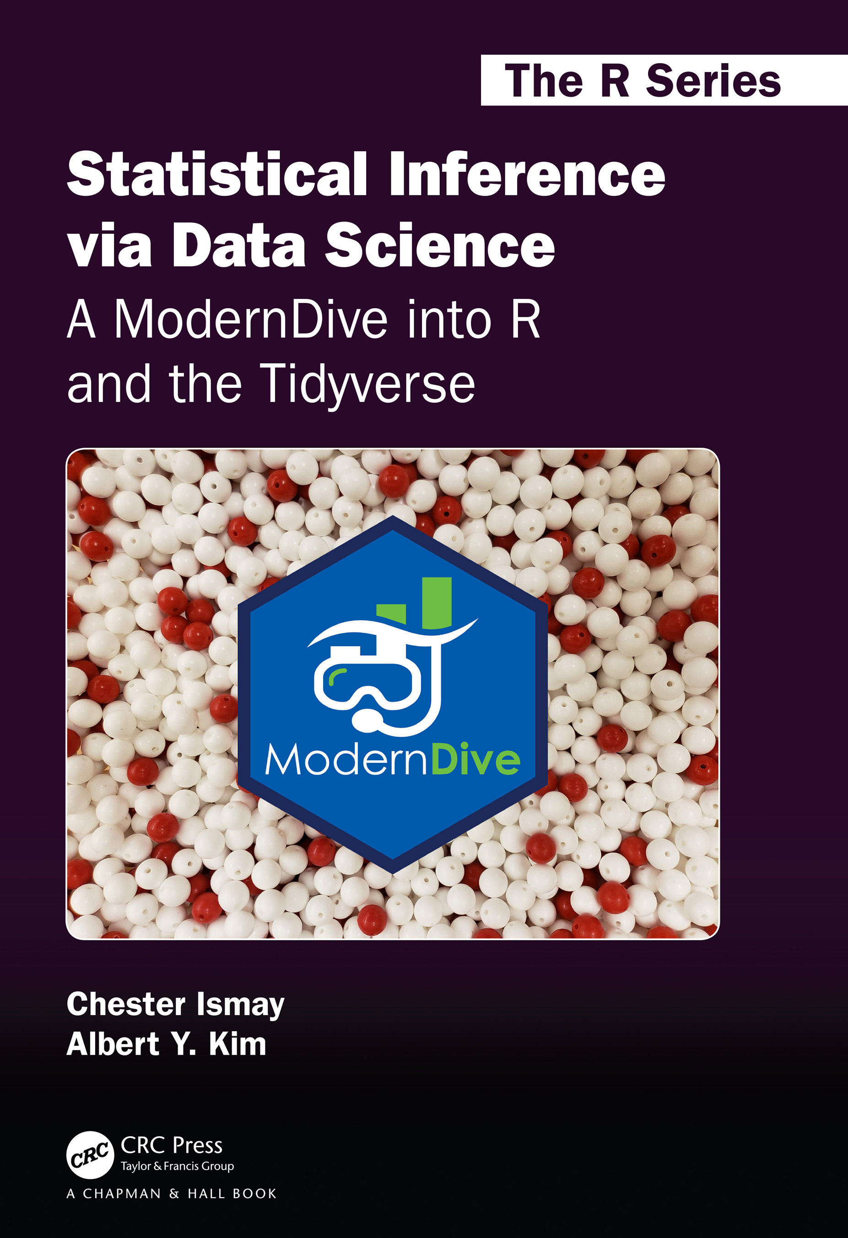
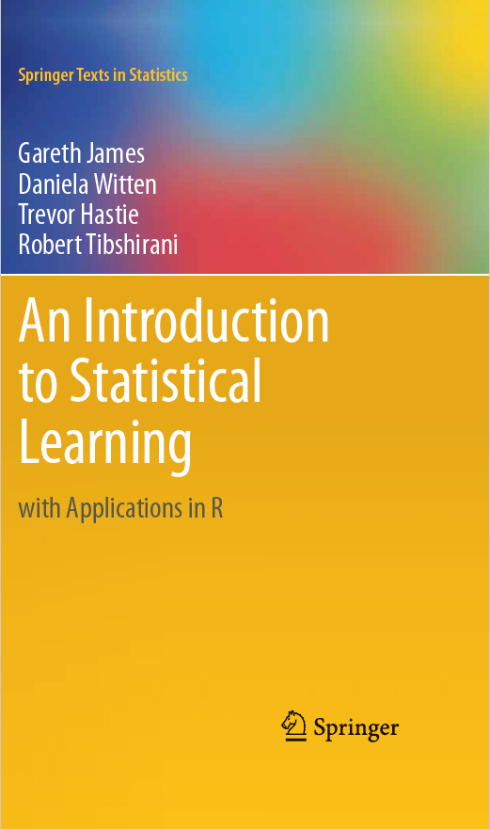
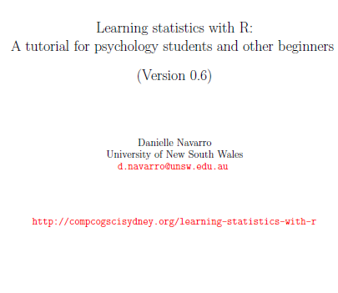
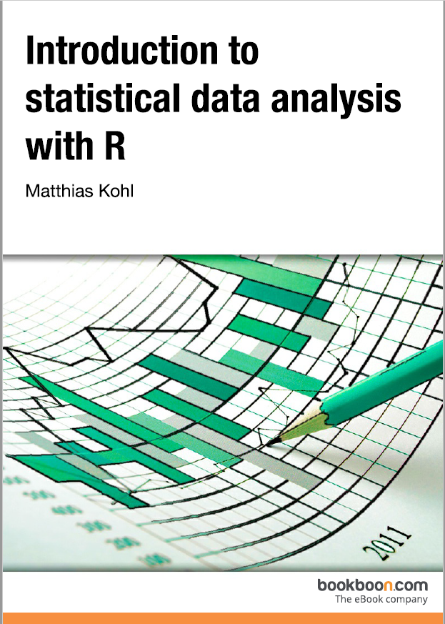
Credits
Our Main Textbook for the course:
  Ismay, Chester, and Albert Y. Kim. Statistical inference via data science: A ModernDive into R and the tidyverse. Chapman and Hall/CRC, 2019. Get an electronic copy from the UCCS Library. Or
  See open source copy of the textbook here: https://moderndive.com/ .
Data Mining Concepts and Techniques, Han et al, 2011

Slide 4
Confidence Interval – Section 8
Re-Sampling (8.1 – 8.2)
Understanding confidence intervals (8.3)
Constructing confidence intervals with infer package (8.4)
Interpreting confidence intervals (8.5)
Comparing bootstrap and sampling distributions (8.7.1)

Slide 5
Point Estimate vs. Confidence Interval
As opposed to a point estimate/sample statistic that estimates the value of an unknown population parameter with a single value, a confidence interval gives what can be interpreted as a range of plausible values.

Slide 6
Confidence Interval
A confidence interval, in statistics, refers to the probability that a population parameter will fall between a set of values for a certain proportion of times.
Analysts often use confidence intervals than contain either 90%, 95% or 99% of expected observations
Thus, if a point estimate is generated from a statistical model of 10.00 with a 95% confidence interval of 9.50 - 10.50, it can be inferred that there is a 95% probability that the true value falls within that range.

Slide 7
Confidence Interval
All other things being equal, higher confidence levels correspond to wider confidence intervals, and lower confidence levels correspond to narrower confidence intervals.
Statisticians use confidence intervals to measure uncertainty in a sample variable.
For example, a researcher selects different samples randomly from the same population and computes a confidence interval for each sample to see how it may represent the true value of the population variable.

Slide 8
Calculating Confidence Interval
Suppose a group of researchers is studying the age of University professors.
The researchers take a random sample. To make it easier in context, assuming we are using the Teaching evaluations at the UT Austin datasets (evals) from the population and
Establish a mean age of 48.

Slide 9
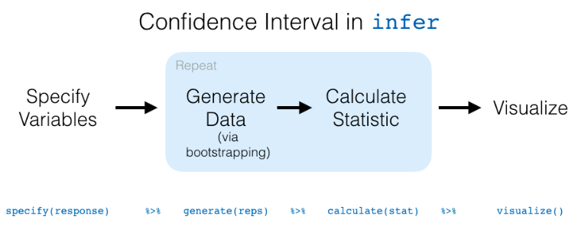
Constructing Confidence Interval

Slide 10
Confidence Interval – Section 8
Re-Sampling (8.1 – 8.2)
Understanding confidence intervals (8.3)
Constructing confidence intervals with infer package (8.4)
Interpreting confidence intervals (8.5)
Comparing bootstrap and sampling distributions (8.7.1)

Slide 11
Calculating Confidence Interval
The mean age of 48 is a point estimate of the population mean.
A point estimate by itself is of limited usefulness because it does not reveal the uncertainty associated with the estimate; you do not have a good sense of how far away this age 48 sample mean might be from the population mean.
What's missing is the degree of uncertainty in this single sample.

Slide 12
Confidence Interval
Confidence intervals provide more information than point estimates.
By establishing a 95% confidence interval using the sample's mean and standard deviation, and
Assuming a normal distribution as represented by the bell curve, the researchers arrive at an upper and lower bound that contains the true mean 95% of the time. This is explained further in the lecture

Slide 13
Calculating Confidence Intervals
Hence, for this question:
  Assume the interval is between ages 40 and 50. If the researchers take 100 random samples from the population of University Professors as a whole, the mean should fall between 40 and 50 of those samples.

Slide 14
Calculating Confidence Intervals
If the researchers want even greater confidence, they can expand the interval to 99% confidence.
Doing so invariably creates a broader range, as it makes room for a greater number of sample means.
If they establish the 99% confidence interval as being between ages 38 and 53, they can expect 99 of 100 samples evaluated to contain a mean value between these numbers.

Slide 15
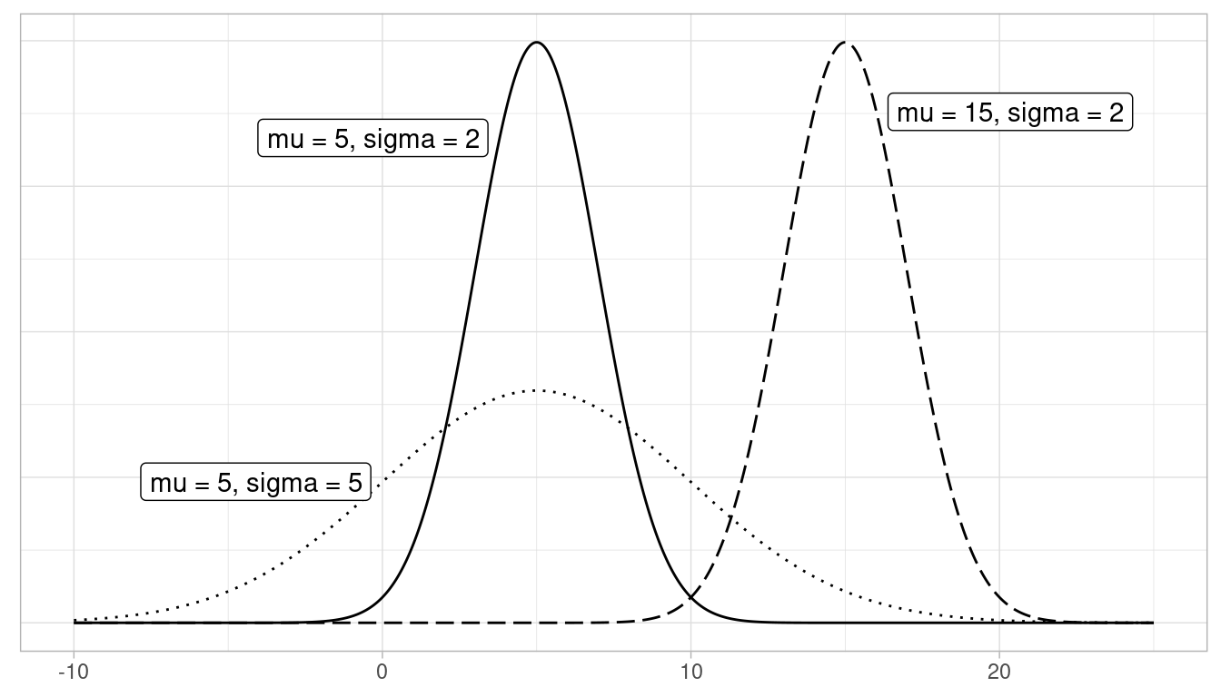
Normal Distribution

Slide 16
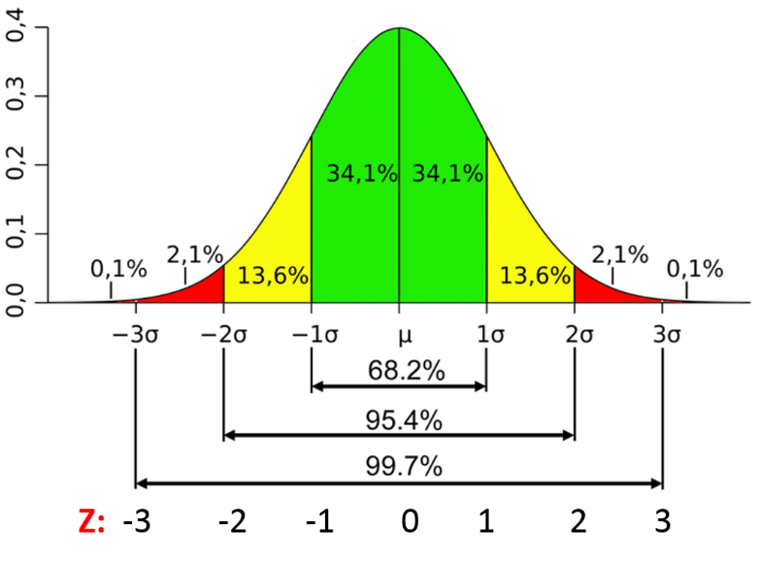
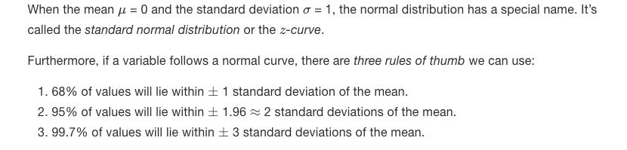

Slide 17
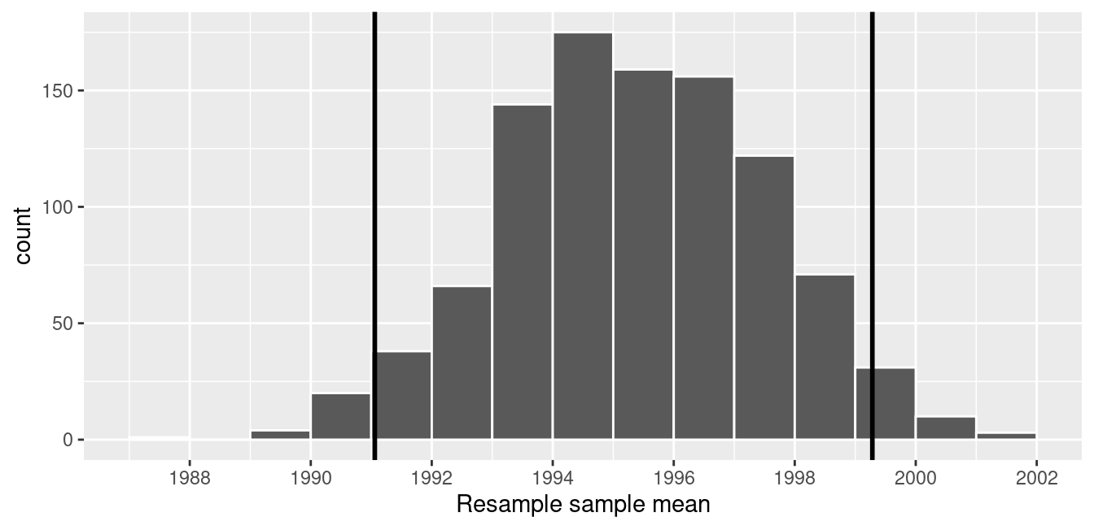
Percentile Method 95% Confidence Interval
About 95% of the mean_year variable values in virtual_resampled_means fall between 1991.059 and 1999.283, with 2.5% to the left of the leftmost line and 2.5% to the right of the rightmost line.

Slide 18

Standard Error Method for Confidence Interval
Using our 95% rule of thumb about normal distributions, we can use the following formula to determine the lower and upper endpoints of a 95% confidence interval for μ.

Slide 19
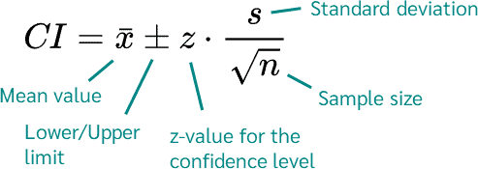
Confidence Interval
Examined in detail in Lecture 9
A confidence interval is the mean of your estimate plus and minus the variation in that estimate.
This is the range of values you expect your estimate to fall between if you redo your test, within a certain level of confidence.

Slide 20
Confidence Interval
Examined in detail in Lecture 9
A confidence interval is the mean of your estimate plus and minus the variation in that estimate.
This is the range of values you expect your estimate to fall between if you redo your test, within a certain level of confidence.

Slide 21
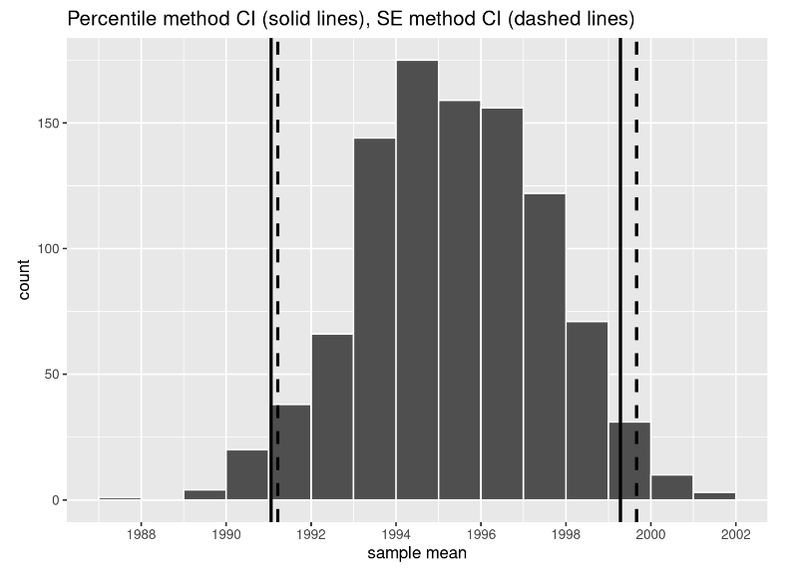
However, we can only use the standard error rule when the bootstrap distribution is roughly normally shaped.

Slide 22
In Class Reading and Discussion
Today’s reading is Chapter 8: Bootstrapping and Confidence Interval
Sections 8.1 – 8.5 and 8.7.1
Assigned time: 30 mins. 10:30 am – 11:00 am
Review Points for discussion (11:00am - 11:15 pm)

Slide 23
Common Misconception about Confidence Interval
The biggest misconception regarding confidence intervals is that they represent the percentage of data from a given sample that falls between the upper and lower bounds.
In other words, it would be incorrect to assume that a 99% confidence interval means that 99% of the data in a random sample falls between these bounds.
What it actually means is that one can be 99% certain that the range will contain the population mean.

Slide 24
In-Class Exercise
In your own words, describe/compare sampling and bootstrap distributions?
If both distributions are used for a data will there be "significant” difference in observation on how it impacts the confidence interval?
To confirm you point in the answer above, use any data of your choice and compare the two types of distribution. Visualize your data and explain.

Slide 25
Course Project Proposal
Review the course project proposal question:
https://academics.uccs.edu/~ooluwada/courses/dataanalytics/Project/Term_Project_Proposal_Question.html

